Slide 1
Making the Best of the Short Bunk
Scaling your servers with async/await

Slide 2







Platinum Sponsors
Gold Sponsors
Notes:
Please take a brief opportunity and thank our platinum and gold sponsors. They have invested a lot of time and money into making That Conference the success it is.

Slide 3
Who is this guy?

Slide 4


Slide 5
Overview
Notes:
This talk is about how async/await works on the server side. Some of this talk will only apply to ASP.NET; some will apply to any kind of server.
In this first section, we’ll do a conceptual overview of async/await, compare it to Node.js, and cover some semantics.
In the next section, we’ll bring out some common problems when you use async/await on the server side.
Next, we’ll cover a few reusable techniques, or async “code patterns” that will help you write good async code.
Finally (time permitting), we’ll look at the current state of library and framework support for async, with an eye towards the best approach in various scenarios.

Slide 6
Benefits of Async
On the client, the primary benefit is responsiveness.
Keeping the UI thread free.
Most async resources assume client-side.
On the server, the primary benefit is scalability.
“10x to 100x” scalability improvement.
Handles bursting traffic.
Asynchronicity drives the scalability of Node.js as well.

Slide 7
Overview
Compare synchronous requests to asynchronous.
Illustrations assume a thread pool to handle requests.
Note the difference between thread and context.
Notes:
We’ll compare a synchronous request handler with an asynchronous request handler.
Thread pools are common for servers, but the same principle holds for single-threaded servers (e.g., Node.js, self-hosted WCF, Azure worker roles are all commonly single-threaded).

Slide 8
Overview: Synchronous Requests
Waiting
Waiting
Waiting
Waiting
Notes:
One thread per request – a common approach in simple ASP.NET apps, or if writing your own TCP/IP server.
There’s a thread pool (ha, ha) on the left, and requests come in on the right.
[CLICK] The first request comes in.
[CLICK] A thread pool thread is dispatched to handle the request, blocking the thread.
[CLICK] The request will wait for an external resource. While waiting, the thread is still blocked.
[CLICK] Eventually, the external call will complete, and the request resumes executing (still on the same thread).
[CLICK] When the request completes, the thread is freed and returned to the thread pool.
[CLICK] This gets interesting when you have more requests than threads.
[CLICK] All existing threads are assigned to requests.
[CLICK] These requests also wait for external resources, blocking those threads.
The third request has to wait for a free thread before it can start. It is in danger of a 503.
In this situation, the threads are blocked but are not doing anything useful.

Slide 9
Overview: Asynchronous Requests
Waiting
Waiting
Waiting
Waiting
Notes:
Now let’s look at how asynchronous requests are handled.
[CLICK] When a request comes in, a thread pool thread is assigned and blocks working on that request.
[CLICK] When the request waits on an external resource, the thread is immediately freed back to the thread pool.
- While the thread is in the thread pool, it does not have a request context.
[CLICK] Eventually, the external call completes, and the request is ready to resume.
[CLICK] A thread pool thread is assigned to the request, and continues working on it.
This can be any thread pool thread, not the same thread.
When a thread resumes a request, it enters the request context.
[CLICK] When the request completes, the thread is returned to the thread pool.
[CLICK] Now, when there are more requests than threads…
[CLICK] Available threads are assigned to those requests.
[CLICK] As soon as the requests wait on external resources, their threads are freed to work on other requests or to return to the thread pool.
So we see that asynchronous requests allow a smaller number of threads to handle a larger number of requests.

Slide 10

Overview: The Question
The question that is always asked:
Why not just increase the threadpool?
Notes:
Requests (and Tasks) can scale much better than threads.
Threads have ~1MB stack, plus kernel stack (unpageable).

Slide 11
What about Node.js?
.NET async/await enables maintainable asynchronous code.
ASP.NET has supported asynchronous handling at least since .NET 2.0.
JS currently has callbacks (+promises). Code is still awkward.
ES6 introduces generators which will simplify async code.
Available today (as of 2013-05-13) in V8 3.19 / Node.js 0.11.2 (Unstable)
Pass --harmony or --harmony-generators

Slide 12
What about Node.js?
Tradeoff 1: No standard practice.
.NET uses Task-based Asynchronous Pattern (TAP)
JavaScript will use… http://tinyurl.com/meeucu6
Q? Suspend? Genrun? Continuable? Co? Other promises?
Notes:
I think JS libraries will standardize on callbacks instead of generators (at least for now).
Consumers will have to translate to their promise/continuation library of choice.

Slide 13
What about Node.js?
Tradeoff 2: Single-threaded.
Solution: Use Cluster (built-in). Or IISNode.
Also recommended:
Load balancer (nginx or a separate node.js app).
Shared-memory out-of-proc cache (optional).
Worker recycling.
Log collection.
Notes:
I recommend using IISNode or designing for scaleout and only using 1- or 2-core machines.

Slide 14
What about Node.js?
Choosing between ASP.NET and Node.js:
Built-in support vs. library choice (e.g., MVC).
Standardized TAP vs. library choice (promise/continuation).
C#/VB async vs. JS generators.
C#/VB (Xamarin PCLs/desktop/ASP.NET) vs. JS (PhoneGap/browser/Node.js).
Neither is a clear-cut winner; depends on your needs.
Notes:
First two points are philosophical differences; last two are language differences.
JS generators not quite there.
C#/VB Xamarin PCLs not quite there, and will never have good browser support.
JS enables more code reuse for websites (e.g., validation).
For the remainder of this talk, we’ll only be discussing async/await.

Slide 15
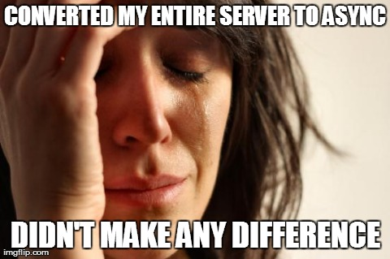
What Async Doesn’t Do
Async does not change HTTP.
Async does not scale out.
Async won’t help with a single DB backend, or if your (outgoing) requests are always fast.
http://tinyurl.com/k2samwm

Slide 16
More about Context
AspNetSynchronizationContext (“request context”):
HttpContext.Current (including Items).
Identity (User/Principal).
Culture.
ExecutionContext (not affected by ConfigureAwait):
Impersonation.
Security (CAS allow/deny).
LogicalCallContext.
Notes:
SynchrononizationContext enforces one thread at a time.

Slide 17
More about Context
Waiting
async Task SaveAsync()
{
await DbContext.SaveAsync().ConfigureAwait(false);
...
}
Notes:
ConfigureAwait allows you to schedule some work for a request that does not have to enter the request context.
This “request context” is the SynchronizationContext that enforces the “one thread at a time” rule. So on an idle server, ConfigureAwait(false) will get you a small amount of parallelism “for free”.
ConfigureAwait(false) is never less efficient, so use it whenever you don’t need the request context.

Slide 18
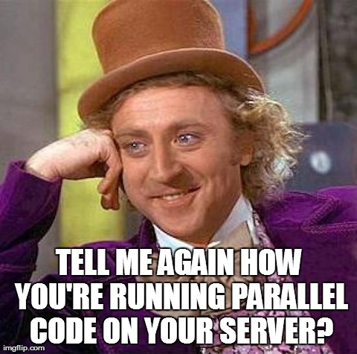
Parallelism and Background Threads
Parallel server code is almost always a bad idea (though it can be useful in controlled environments - known # of users).
Avoid: Parallel/PLINQ, Task.Run, TaskFactory.StartNew, Task.ContinueWith.
Beware: Fake asynchronous methods (e.g. file streams).
Notes:
Concurrency is OK! It’s encouraged! But parallelism not so much.
Parallel code will use multiple threads per request instead of one thread handling multiple requests.
Parallelism cannot use SynchronizationContext, so you can’t use HttpContext.Current or Culture settings.

Slide 19
Fake Asynchronous Methods
Waiting
async Task SaveAsync()
{
await myStream.WriteAllBytesAsync();
await myStream.FlushAsync();
}
Notes:
Fake asynchronous methods consume a thread pool thread so they appear asynchronous. In this example, our methods are assuming that the async stream methods are actually async, but they’re not; internally, they’re queueing synchronous work to the thread pool (e.g., Task.Run).
This means extra thread swapping (inefficient) and using a thread for the entire request (kills scalability).
At no point does this request have all its threads free! It is always using at least one thread.

Slide 20
Aborting ASP.NET Requests
Sync would Thread.Abort on timeout & ignore disconnect.
HttpRequest.TimedOutToken - async timeout.
httpRuntime[@executionTimeout]
HttpResponse.ClientDisconnectedToken - async disconnect.
Do not use for now. http://tinyurl.com/lhxr34x
Different frameworks (WebForms/WebAPI) differ slightly.
Notes:
Aborting is more important as our apps become more dependent on services (e.g., Azure retries with exponential backoff).

Slide 21
Gotchas

Slide 22

ASP.NET Requirements and Settings
.NET 4.5 is required.
Microsoft.Bcl.Async enables async/await on .NET 4.0 desktop/SL/WP/WS. It will install without warnings in ASP.NET 4.0 but will not work correctly.
Be sure to target .NET 4.5 or at least turn off SyncCtx “quirk”.
Particularly a problem when upgrading an existing project to 4.5.
httpRuntime[@targetFramework=“4.5”]
appSettings/add[@key=“aspnet:UseTaskFriendlySynchronizationContext”, @value=“true”]
http://tinyurl.com/lbwpagl

Slide 23
Other Useful Settings
IIS/HTTP.sys has default queue limit of 1,000.
At least 5,000 is recommended for async.
Application Pools -> Advanced Settings -> Queue Length
ServicePointManager.DefaultConnectionLimit

Slide 24
ASP.NET Authentication
Use HttpContext.Current.User, not Thread.CurrentPrincipal.
When using ConfigureAwait, this makes the error obvious.
However, CurrentPrincipal is more portable.
Asynchronous authentication:
Set both User and CurrentPrincipal.
http://tinyurl.com/n3yy5mh
Disable fast-path in the async method; use Task.Yield.
http://stackoverflow.com/questions/16653308
Notes:
When executing outside a request context, CurrentPrincipal is just whatever is left on that thread.
Task.Yield ensures CurrentPrincipal is flowed correctly.
(The Yield overhead is minor. The request thread actually is not returned to the thread pool; it resumes immediately.)

Slide 25
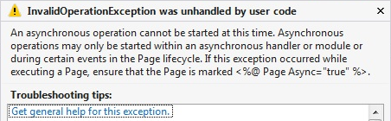
ASP.NET SynchronizationContext
Async void and EAP methods notify SyncCtx of operations.
http://tinyurl.com/6v3azg4
ASP.NET will catch improper use of SyncCtx and throw:
Notes:
The most common cause of this right now is WebClient (EAP) instead of HttpClient (TAP).
Possible EAP workarounds: Task.Run or a “switcher” using SynchronizationContext.SetSynchronizationContext.

Slide 26

Thread-Local State
Remove:
[ThreadStatic]
ThreadLocal<T>
Thread data slots
CallContext.[Get|Set]Data
Replace with:
HttpContext.Current.Items
AsyncLocal<T> (not yet available)
CallContext.Logical[Get|Set]Data (if you must)
Notes:
Logical Get/Set Data is more portable than Items and flows outside the request context.
However, you should only store immutable data there. Microsoft.Bcl.Immutable.

Slide 27
Techniques

Slide 28
Libraries
Use ConfigureAwait(false).
http://tinyurl.com/q489p2u
Do not use Task.Run (“fake asynchronous” methods).
Task.Run should not be used to make a naturally-synchronous method appear asynchronous: http://tinyurl.com/nyuc48z
End-user client code may call CPU-bound methods using Task.Run, but Task.Run should not be used in the implementation of those methods.
If a method is both I/O and CPU-bound, then it should have an asynchronous signature but all CPU work should be blocking. Be sure to document this well.
Notes:
These notes apply to any library code, but particularly libraries shared between UI and ASP.NET apps.

Slide 29
Lazy Initialization
A shared resource that needs async initialization.
Usually a singleton.
Fast-path once the initialization completes.
Nito.AsyncEx package has an AsyncLazy<T> type: http://tinyurl.com/lpqmp7a
Or build your own: http://tinyurl.com/mhhq769

Slide 30
Caching
Tip: Cache the Task<T> instead of the T.
Fast-path allows your requests to synchronously continue if the result is already in the cache.
If some cache entries are synchronous, you can use Task.FromResult.
Serialization
Try not to serialize tasks (semantic mismatch).
Task<T> is not serializable.

Slide 31
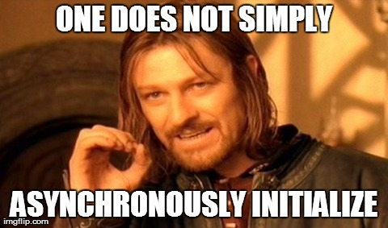
IoC / DI Service Initialization
interface IAsyncInitialization { Task Initialization { get; } }
class MyService : IMyService, IAsyncInitialization {
public MyService() { Initialization = InitializeAsync(); }
public Task Initialization { get; private set; }
private async Task InitializeAsync() { … }
}
IMyService myService = MyIoC.GetService<IMyService>();
var asyncMyService = myService as IAsyncInitialization;
if (asyncMyService != null) await asyncMyService.Initialization;
Notes:
AsyncLazy<T> works great for properties, but not IoC/DI.

Slide 32
Classical OOP
Async/await considerations with:
Interfaces and base types.
Factories and IoC/DI.
Properties.
Events.
IDisposable.
http://tinyurl.com/l7wegjr
Notes:
These are pointers to a series of articles on my blog exploring async/await and how it fits (or doesn’t fit) into classical OOP.

Slide 33

Returning Early
This is not you.
Notes:
Your situation is not unique.
Your company is not a precious little snowflake.
If I had a dollar for every custom .NET threadpool implementation I’ve seen that was completely unnecessary, I’d have about five bucks. I have yet to see a custom .NET threadpool that was necessary.

Slide 34

Returning Early
Correct solution:
Persistent storage (Azure queue, MSMQ, WebSphere MQ, etc.).
Processing backend (Azure worker role, Win32 service, etc.).
Completion notification (Azure message bus, SignalR, AJAX polling, etc.).
Incorrect solutions:
Task.Run, Task.ContinueWith, TaskFactory.StartNew.
But if you must: http://tinyurl.com/pv9ubp5
Notes:
Async doesn’t change the HTTP protocol. You still only have one response per request, and “await” will not cause a response to be sent.
However, returning early can be useful in a handful of situations, e.g., updating a local on-disk cache after the response returns. NOT useful for logging!
Code on my blog will track async/sync tasks executing outside the request context and notify ASP.NET that they’re running. Also publishes a CancellationToken which is set when ASP.NET has requested the AppDomain to exit.
But don’t use this unless you are perfectly fine with the task never being executed!

Slide 35
Main Loop
For systems without a SynchronizationContext, Nito.AsyncEx has a single-threaded context: AsyncContext.Run(delegate).
Win32 services, Azure worker roles.
Similar architecture to Node.js.
Remembers and restores previous context, so also useful when you have to work around lack of framework support.
Will synchronously block and wait for asynchronous code.
Sort of like a “nested message loop”.
Cannot call any code that assumes a different context (i.e., ASP.NET context).
Notes:
E.g., ASP.NET MVC child actions.

Slide 36
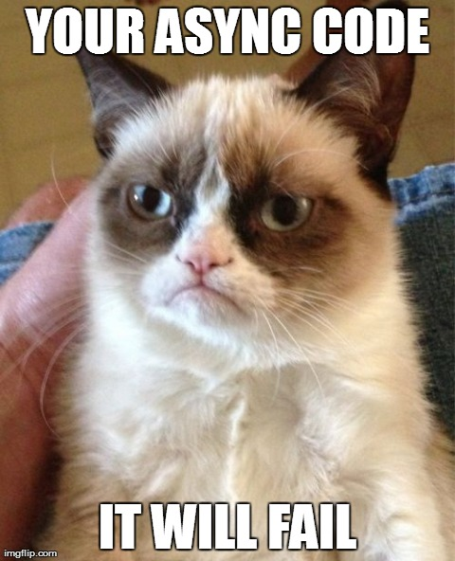
Diagnostics
What is a call stack/stack trace?
Nito.AsyncEx.AsyncDiagnostics (Prerelease):
Install NuGet package.
Add [assembly: AsyncDiagnosticAspect]
When you log exceptions, log ToAsyncDiagnosticString() instead of ToString().
Does have some runtime overhead.
http://tinyurl.com/qf53b66
Notes:
Question: who thinks a stack trace tells you where the code came from (i.e., how you got there)? Actually, a stack trace tells you where your code is going!
For synchronous code, those are the same thing. For async code, they’re not.
AsyncDiagnostics works by storing immutable stacks in Logical Get/Set Data, and attaching a copy of that stack to the Data member of every Exception that is thrown.

Slide 37
Framework/Library Support
Notes:
Existing frameworks (and libraries) have very strong backwards-compatibility requirements that can make new features like async/await a bit awkward or unusable in some scenarios.

Slide 38
Newer Development: Full Async Support
WebApi:
Async controllers.
Entire pipeline is async (async filters, handlers, etc).
SignalR:
Full support for async.
Sometimes has ASP.NET SyncCtx, depending on connection protocol.
http://tinyurl.com/o7ajz7j - should be fixed in 2.0 RTW.

Slide 39
Newer Development: Full Async Support
Entity Framework 6 (Beta)
Don’t use lazy loading in async code!
HttpClient
Azure Storage Client Library 2.1 (RC)

Slide 40
ASP.NET
Http Handlers: HttpTaskAsyncHandler
Http Modules:
Wrap async handler in EventHandlerTaskAsyncHelper.
That wrapper exposes BeginEventHandler and EndEventHandler properties, which you then pass to AddOnBeginRequestAsync from your Init method.
Wrapper translates TAP (async Task) to APM (Begin/End/IAsyncResult).

Slide 41

ASP.NET MVC: Partial Async Support
Supported:
Async controller actions.
Cancellation.
Not supported:
Async filters. http://tinyurl.com/kcpkfeu
Async child actions. http://tinyurl.com/mba2esh
Task.Run or AsyncContext.Run.
Notes:
Async child actions: AsyncContext.Run can only be used within a child action.

Slide 42
ASP.NET WebForms
http://tinyurl.com/c8x9kch
Page.Async
Async support is “opt-in”.
Page.RegisterAsyncTask / PageAsyncTask
ASP.NET team prefers these over async void event handlers.
Page.AsyncTimeout
Provides CancellationToken to PageAsyncTask method.

Slide 43
Others
Win32 Service / Azure worker role:
Recommend: installing a Main Loop via AsyncContext.Run (Nito.AsyncEx).
WCF:
Strongly consider ConcurrencyMode.Multiple.
Also consider installing a Main Loop if not hosted on ASP.NET.

Slide 44
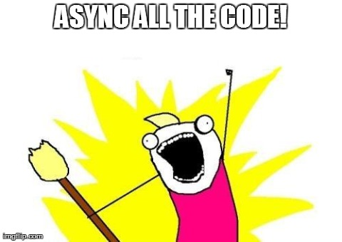
Q&A
Notes:
Resources are available at StephenCleary.com - slides, example code, etc.

Slide 45


August 11th – 13th 2014
Same Place, Same Time
Notes:
At the end of your presentation we would be grateful if you could help us announce next years date.

